Slide 1
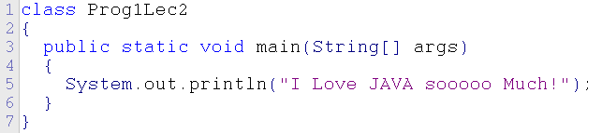
Java basics
Main Java method
Basic make-up of program
Errors and debugging
Characters and output
Strings
Variables and initialization
Notes:
P. F. Black - JAVA Elective - Introduction Week 1
September 2000 - CM147

Slide 2
Week2.java
Start JCreator and create a new file called Week2
Add a line to show the program starts
class Week2
{
public static void main(String[] args)
{
System.out.println(“Program start");
}
}
Compile, debug and run the program

Slide 3
Errors
In debugging a program it is important to understand types of errors and error messages
class Week2
{
public static void main(String[] args)
{
System.out.println(“Program start");
}
}
Add another s to class – classs and compile again.

Slide 4
Structure error
--------------------Configuration: JDK version 1.5.0_02 <Default>--------------------
U:\Prog1 2005\Week2.java:1: 'class' or 'interface' expected
classs Week2
^
1 error
Process completed.

Slide 5
Bracket error
Remove the first curly bracket after correcting the reserved word class.
The Java error is quite clear – it is expecting an opening bracket at line 2
U:\Prog1 2005\PWeek2.java:2: '{' expected
^
1 error
Process completed.

Slide 6
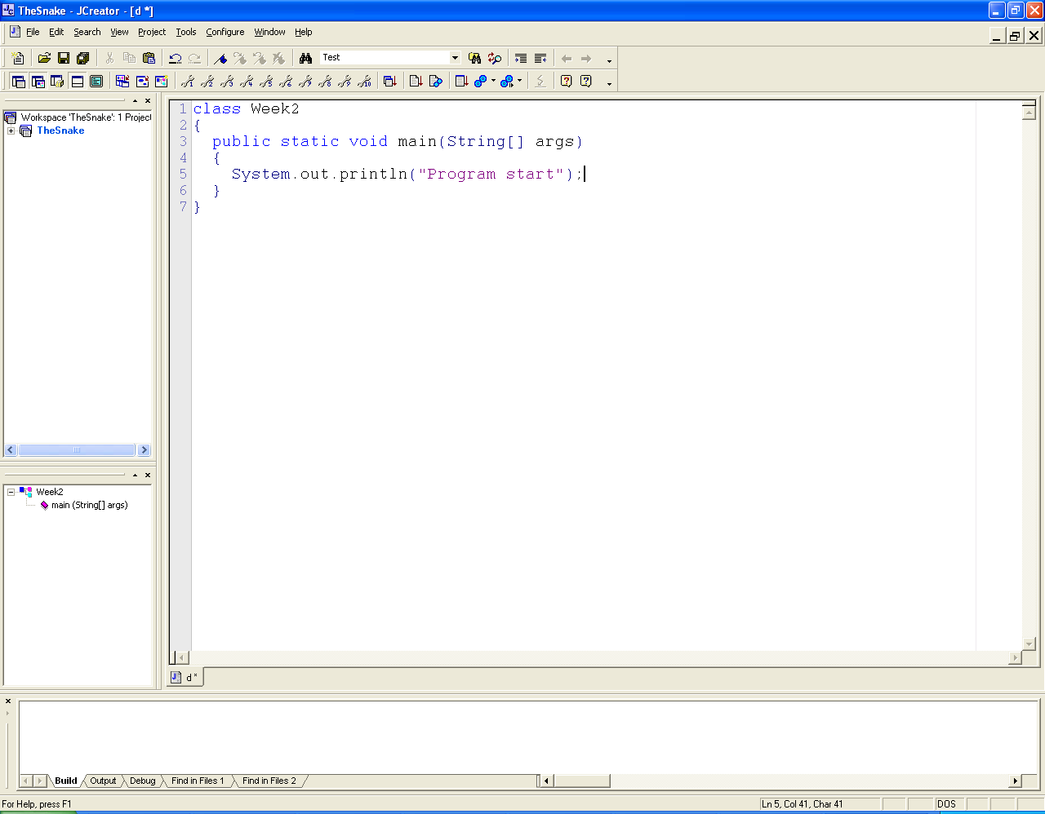
Missing last bracket
U:\Prog1 2005\Week2.java:7: '}' expected
^
1 error

Slide 7
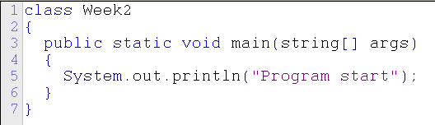
Try Lowercase string
U:\Prog1 2005\Week2.java:3: cannot find symbol
symbol : class string
location: class Week2
public static void main(string args[])
^
1 error

Slide 8

Try Missing semicolon
This is the most common error message
U:\Prog1 2005\Week2.java:5: ';' expected
}
^
1 error

Slide 9
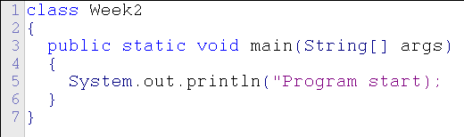
Multiple errors reported
Miss the last quote from “Program start”
U:\Prog1 2005\Week2.java:5: unclosed string literal
System.out.println("Program start);
^

Slide 10
Special codes – the slash \
Sometimes you want text to appear a certain way
Some special codes help
\t is the special code for a TAB
\n is the special code for a new line
Try using them to print the following using 1 line of code in a new program.
Bill 19 Computing
Joe 18 IT
Les 19 Engineering

Slide 11

\n and \t

Slide 12
Special codes \” & \\
Try a new program – call it ‘Prog3’
Try to get it to print out
  Is this “what” you wanted
Then get the program to print on the next line
  C:\temp\java\prog1
Then print it surrounded in quote marks
  “C:\temp\java\prog1”

Slide 13

\\ and \”

Slide 14
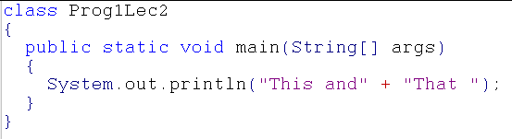
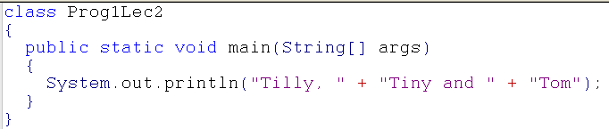
New File - Strings
    Concatenation is joining two or more things together – Strings are things in quotes.
    One way in Java with text (Strings) is to use a ‘+’ sign – try the following two programs.

Slide 15
Strings
You have seen the Java keyword String
A String is some memory that can hold characters
Java has a special way of declaring bits of memory that hold characters
myName is a variable of type String that can hold a string of characters but you can think of it as a memory box.
Variable type variable name value contained in variable
String myName = "Paul";
System.out.println(myName);

Slide 16
Strings and output
String myName = "Paul";
System.out.println(myName);
The box is called myName
The line above says to print out the contents of the box called myName
myName
“Paul”
System.out.println(myName);

Slide 17
Strings
class Prog4
{
public static void main(String[] args)
{
String myName = "Paul";
System.out.println(myName);
}
}
To change the contents of the box – just say
the box name = something else
See next slide, try it a few times

Slide 18
Strings
class Prog5
{
public static void main(String[] args)
{
String myName = "Paul";
myName = "Julie";
myName = "Fred";
System.out.println(myName);
}
}

Slide 19
Concatenation
Try the following – two variables
class Prog4
{
public static void main(String[] args)
{
String myName = "Paul";
String myOtherName = "Leonard " + "Cohen";
myName = myName + " Black";
System.out.println(myName);
System.out.println(myOtherName);
System.out.println(myName + myOtherName);
}
}

Slide 20
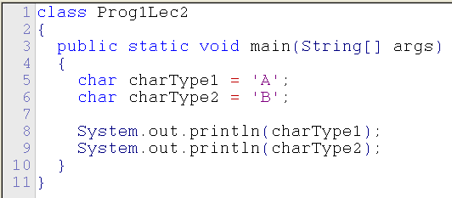
Primitive types
Java has other types of variables for different types of data
These all begin with lowercase letters
For characters there is a char type
Variable type
Variable name
Variable starting value
Single Quotes
This prints the VALUE in each variable
A char type can only hold a single character at any time

Slide 21
Primitive types
If we are using whole numbers, we usually use a type of int – try this program:
class Prog5
{
public static void main(String[] args)
{
int age = 19;
int oldAge = 90;
int teenage = 15;
System.out.println("My age is " + age);
System.out.println("Some rock stars look " + oldAge);
System.out.println("I wish I was " + teenage);
}
}

Slide 22
Addition
class Prog5
{
public static void main(String[] args)
{
int age = 19;
int oldAge = 90;
int teenage = 15;
int allAges = age + oldAge + teenage;
System.out.println("My age is " + age);
System.out.println("Some rock stars look " + oldAge);
System.out.println("I wish I was " + teenage);
System.out.println("Total of ages is " + allAges);
}
}
Addition
Print total

Slide 23
Primitives
An int cannot hold a real number
For real numbers e.g. (23.45) Java has two main types float and double
A float holds huge numbers and doubles hold even bigger and more precise numbers
A float type has a bit of a problem in that the number must have an ‘f’ after it or you will get an error – try the program on the next slide

Slide 24

Float & Double
class Prog6
{
public static void main(String[] args)
{
float bigNumber = 2345.65f;
double hugeNumber = 123455565.56789;
System.out.println("A big number is " + bigNumber);
System.out.println("A huge number is " + hugeNumber);
}
}
Remember the ‘f’ – then see
the error if it isn’t there
These can print out in scientific notation which looks a bit odd

Slide 25
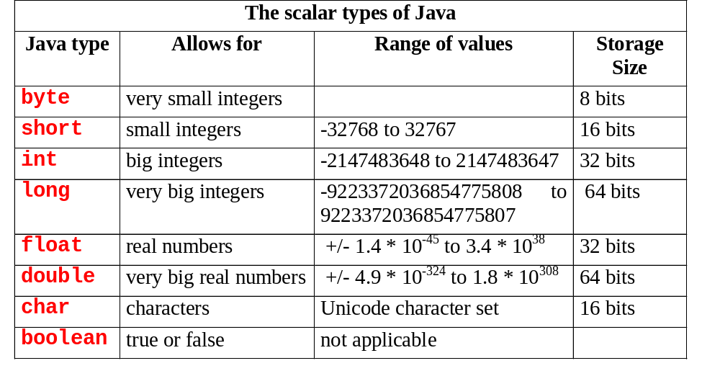
All primitives

Slide 26
Primitives
Try writing a program that declares a variable for each type and print out the value of each type.
We’ll come on to how to do calculations using +, -, / and % operators next week.

Slide 27
Copying values
Try to copy one variable into another type
Some the compiler allows
Some it doesn’t but for different reasons
Short, Int, char, float, double, boolean, String

Slide 28
Learning outcomes
Main Java method
Basic make-up of class
Errors and debugging
Characters and output
Strings
Primitives
Variables and initialization

